Slide 1
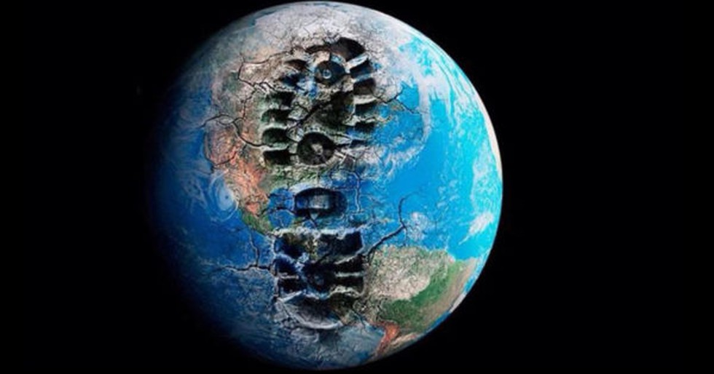
The Contemporary Conjuncture
climate catastrophe: climatology
the 6th mass extinction: biology
the “Anthropocene”: geology

Slide 2
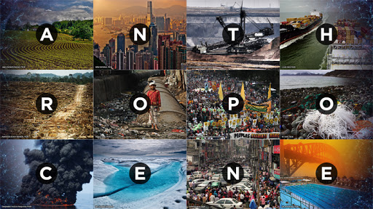
Notes:
The A is the epoch in which we are inhabiting.
The burning Q. is: has it been thrust upon us? Does it craft same sets of implications across divergent spatial scales and different societies and communities?
But before we pose these Q.s, it is important for us to know what the A is all about. And of course it is the grand context which can provide us with entry plane for the Urbanocene.

Slide 3
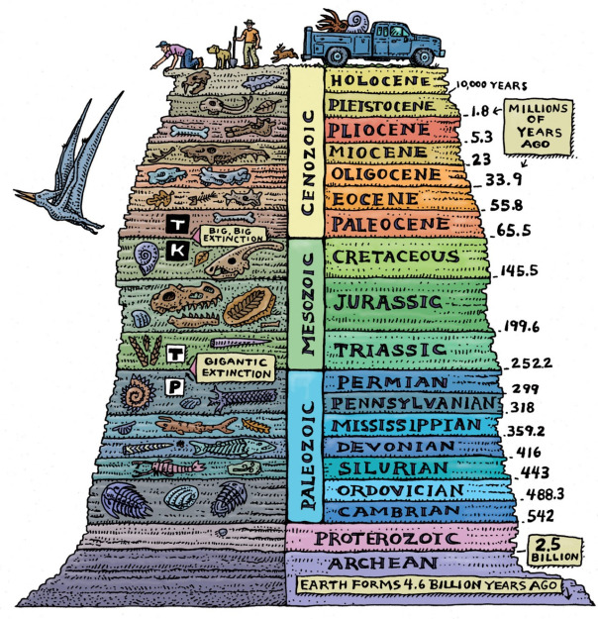
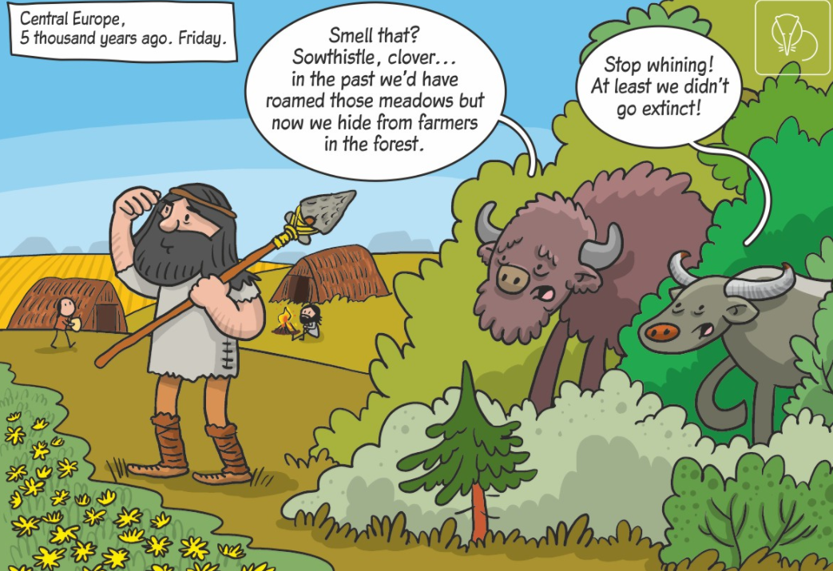
From Holocene to Anthropocene
Notes:
What is A?
Holocene started 11,650 years ago; H = period of stable climate followed by the last glacial period
From Holocene to Anthropocene
The Anthropocene is functionally and stratigraphically distinct from the Holocene (Waters et al., 2016).

Slide 4
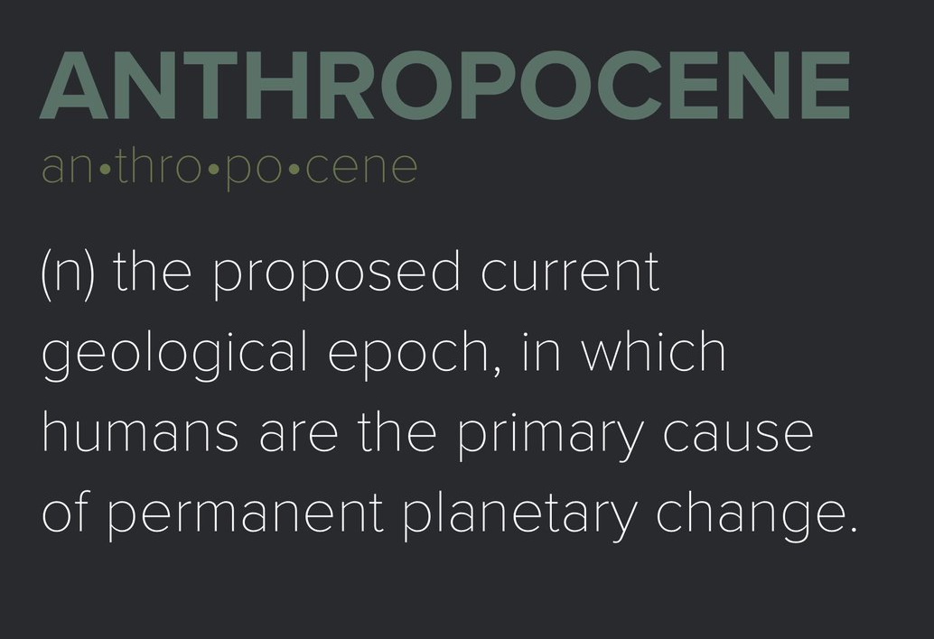
“Age of Humans”
Crutzen and Stoermer (2000), The “Anthropocene”
anthropozoic era – Stoppani (1873); anthropogenic age – Pavlov (1913); ‘noösphere’ – Teilhard de Chardin and Le Roy (1924)
expansion of mankind in the past three centuries in numbers (a ten-fold increase!)
per capita exploitation of earth’s resources
urbanization has increased tenfold in the past century
emission of CO2, SO2, NO, CO
The “Anthropocene” – central role of humans
Notes:
Paul Crutzen and Eugene Stoermer first introduced the idea of the Anthropocene in the newsletter of the International Geosphere-Biosphere Programme (IGBP) in the year 2000.
Stoermer – informal discussions on A since the 1980s; more popularized by Crutzen who also discovered the ozone hole and it also fetched him the Nobel Prize.
They drew insights from works by several scholars of preceding centuries.
Stoppani – power of mankind and its activities – “new telluric force”
“Noosphere” – the world of thought tracing the brain power and techno talent of humankind in shaping its own future and of that of the environment.
Whole lot of data and figures on emission and emission rate

Slide 5
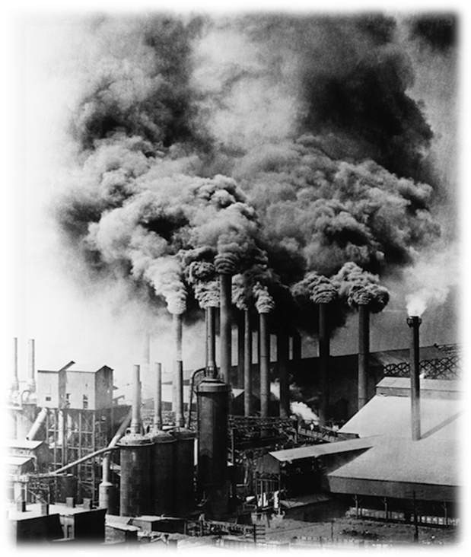
The dating debate
Crutzen and Stoermer – industrialization
CO2 concentration in atmosphere from 270–275 parts per million (ppm) to 310 ppm in the mid-twentieth century
From linear to exponential growth – the “Great Acceleration” (Steffen 2005; Steffen et al. 2015); the “1950s syndrome” (Pfister 1995)
Notes:
Three main processes worked together: first, the mechanization of manual labor; second, mechanical production and the transformation of energy using the steam engine; and third, the large-scale exploitation, production, and use of coal and iron.
Starting in the nineteenth century, British industrial cities such as Manchester, Glasgow, and even London acquired the dubious honorific ‘‘Big Smoke’’ (Ueko¨tter 2009: 20–65).
GA – the period of ‘development’ – the construction of dams, automobiles, telephones, and McDonald’s restaurants, and economic indicators such as the increase in international tourism, foreign investments, and gross national product

Slide 6
Stratigraphic Signatures
The Anthropocene Working Group
Report to be submitted to the Subcommission on Quaternary Stratigraphy
International Commission on Stratigraphy > International Union of Geological Sciences
To what extent are human actions recorded as measurable signals in geological strata?
Is the Anthropocene world markedly different from the stable Holocene Epoch?
Notes:
AWG formed – report based on stratigraphic investigations to be submitted to the SQS
The questions can be addressed by examining the “stratigraphic signatures”

Slide 7
Evidences
new materials, such as elemental aluminum, concrete, plastic, and carbon particles
alterations in the processes of sediment creation
altered geochemical signals in sediments and ice sheets
increases in nitrogen and phosphorus
presence in sediments and ice of radionuclides released by nuclear bomb testing
changes in the carbon cycle based on data from ice core samples
increase in global temperature and rising sea levels
alterations in biodiversity
Notes:
stratigraphic signatures include a wide variety of possible forms of evidence
new materials, such as elemental aluminum, concrete, plastic, and carbon particles
alterations in the processes of sediment creation, for example due to eutrophication from fertilizers, capture of sediment behind dams, erosion from mining or deforestation
altered geochemical signals in sediments and ice sheets, for example increases in polycyclic aromatic hydrocarbons, pesticide residues
increases in nitrogen and phosphorus
presence in sediments and ice of radionuclides released by nuclear bomb testing
changes in the carbon cycle based on data from ice core samples
increase in global temperature and rising sea levels
alterations in biodiversity, for example homogenization due to agriculture and animal husbandry, and supplanting of established biota by invasive species introduced by humans

Slide 8
From strata to multi-layered arguments…
New stratigraphic signatures!
‘‘The Anthropocene is functionally and stratigraphically distinct from the Holocene’’ (Waters et al. 2016).
From geology to climate science
Transformations in earth systems
“planetary boundaries” and the search for “safe operating space for humanity” (Rockstrom et al. 2009; Steffen et al. 2015)
Notes:
The group found stratigraphic signatures that were either completely new, or fell substantially outside the level of variation of the Holocene; all of these changes were occurring in an accelerated fashion.

Slide 9
References
Bonneuil, Christophe and Jean-Baptiste Fressoz (2016). The Shock of the Anthropocene: The Earth, History and Us. London: Verso.
Crutzen, Paul J. and Eugene F. Stoermer (2000). The ‘‘Anthropocene.’’ Global Change Newsletter (41): 17–18
Petit, Jean-Robert, J. Jouzel, D. Raynaud, N. I. Barkov, J.-M. Barnola, I. Basile, M. Bender, J. Chappellaz, M. Davis, G. Delaygue, M. Delmotte, V. M. Kotlyakov, M. Legrand, V. Y. Lipenkov, C. Lorius, L. Pe´pin, C. Ritz, E. Saltzman and M. Stievenard (1999). Climate and Atmospheric History of the Past 420,000 Years from the Vostok Ice Core, Antarctica. Nature (399): 429–436.

Slide 10

REFERENCES

Slide 11
Pfister, Christian (1995). Das 1950er Syndrom: Der Weg in die Konsumgesellschaft. Bern: Paul Haupt.
Rockstro¨m, Johan, Will Steffen, Kevin Noone, Asa Persson, F. Stuart Chapin, Eric F. Lambin, Timothy M. Lenton, Marten Scheffer, Carl Folke, Hans Joachim Schellnhuber, Bjo¨rn Nykvist, Cynthia A. de Wit, Terry Hughes, Sander van der Leeuw, Henning Rodhe, Sverker So¨rlin, Peter K. Snyder, Robert Costanza, Uno Svedin, Malin Falkenmark, Louise Karlberg, Robert W. Corell, Victoria J. Fabry, James Hansen, Brian Walker, Diana Liverman, Katherine Richardson, Paul Crutzen and Jonathan A. Foley (2009). A Safe Operating Space for Humanity. Nature (461): 472–475.
Steffen, Will (2005). Global Change and the Earth System: A Planet under Pressure. Stuttgart: Birkha¨user.
Steffen, Will, Katherine Richardson, Johan Rockstro¨m, Sarah E. Cornell, Ingo Fetzer, Elena M. Bennett, Reinette Biggs, Stephen R. Carpenter, Wim de Vries, Cynthia A. de Wit, Carl Folke, Dieter Gerten, Jens Heinke, Georgina M. Mace, Linn M. Persson, Veerabhadran Ramanathan, Belinda Reyers and Sverker So¨rlin (2015). Planetary Boundaries: Guiding Human Development on a Changing Planet. Science (349): 1286–1287.

Slide 12
Stoppani, Antonio (1873). Corso di Geologia: Geologia Endografica, Vol 3, G. Bernardoni E. G. Brigola: Milano.
Trischler, Helmuth. (2016). The Anthropocene: A Challenge for the History of Science, Technology, and the Environment. NTM. 24 (3).309-335.
Waters, Colin N., Jan Zalasiewicz, Colin Summerhayes, Anthony D. Barnosky, Cle´ment Poirier, Agnieszka Gałuszka, Alejandro Cearreta, Matt Edgeworth, Erle C. Ellis, Michael Ellis, Catherine Jeandel, Reinhold Leinfelder, J. R. McNeill, Daniel deB. Richter, Will Steffen, James Syvitski, Davor Vidas, Michael Wagreich, Mark Williams, An Zhisheng, Jacques Grinevald, Eric Odada, Naomi Oreskes and Alexander P. Wolfe (2016). The Anthropocene Is Functionally and Stratigraphically Distinct from the Holocene. Science. 351 (6269).

